Slide 1
Shiftboard Invoice System Description
By: Robert Thomas, Maksym Karbovskyy
Date:8/05/2019

Slide 2
Shiftboard API Documentation
https://www.shiftdata.com/#objects
https://github.com/RJT2nd/shiftboard-emailer​
ReadMe link https://github.com/RJT2nd/shiftboard-emailer/blob/master/README.md

Slide 3
Shiftboard Invoice Workflow
Data is put into the system by site supervisor*
(approved by supervisor)
Bi-weekly trigger
grabs data from Shiftboard
Data is temporarily stored in a database
Data is emailed to the 1099s to acquire final approval
Approve button hit, token is sent back to database
Token triggers the backend to send the approved invoice to AP
If not approved email must be manually sent to admin for correction
Admin will fix and send the new updated invoice to AP
Data is temporarily stored in a database for a two week period
*Refer to the user manual for how and where the information is put into Shiftboard

Slide 4
Shiftboard diagram
Pull request
(COTS)
Calls
AWS SES
Shiftboard
Shifts
(Our Product)
Invoicing System
Timecards
Teams
Accounts
Formats the data into invoices
Invoices to 1099s

Slide 5
Shiftboard api important notes
Used objects
accounts
workgroups
shifts
timecards
Workgroup (Team)
Shift
One to One
Many to One Many Shifts per Account
Many to Many
One to One
Account
Timecard
One to One

Slide 6
Shiftboard invoice system summary
Biweekly the program reads the config to see if any changes were made then executes a pull request from shiftboard which grabs all the shifts that happened in that period. The shifts contain the teams and the people that worked for that shift and the timecards submitted by the people. The important user data including the PO is grabbed from the persons account, true work time is grabbed from the shift, payrate for the shift is grabbed from the team,

Slide 7
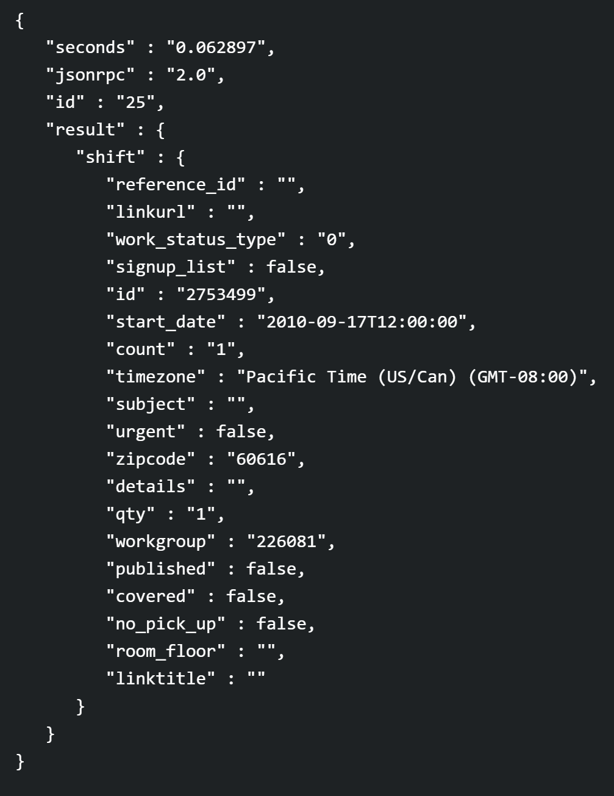
Shift object fields used
Shiftboard API | Shiftboard UI
Date | Date
Workgroup | Team
Start date | Start date
End date | End date

Slide 8
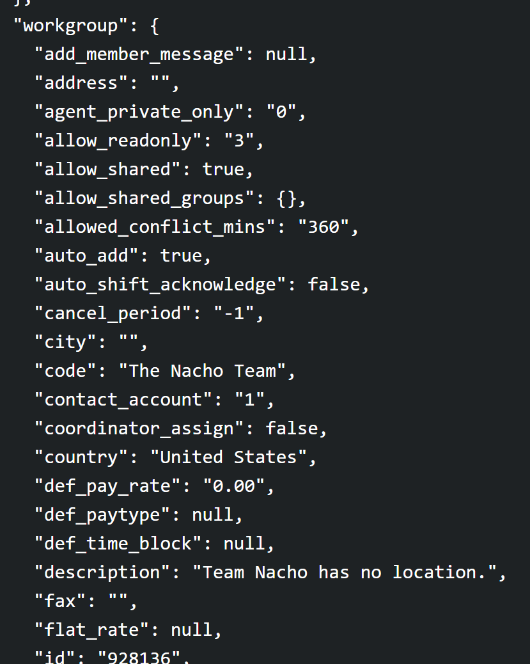
Workgroups(Teams)
Shiftboard API | Shiftboard UI
Def_pay_rate | Pay rate

Slide 9
Timecard object fields used
Mileage
Custom expense field 5 is the ODC field, can be changed to anything but the code would have to be updated to match the change as well as the time card layout
Shiftboard API | Shiftboard UI
Mileage | Mileage
Custom_expense_field_5 | ODC’s

Slide 10
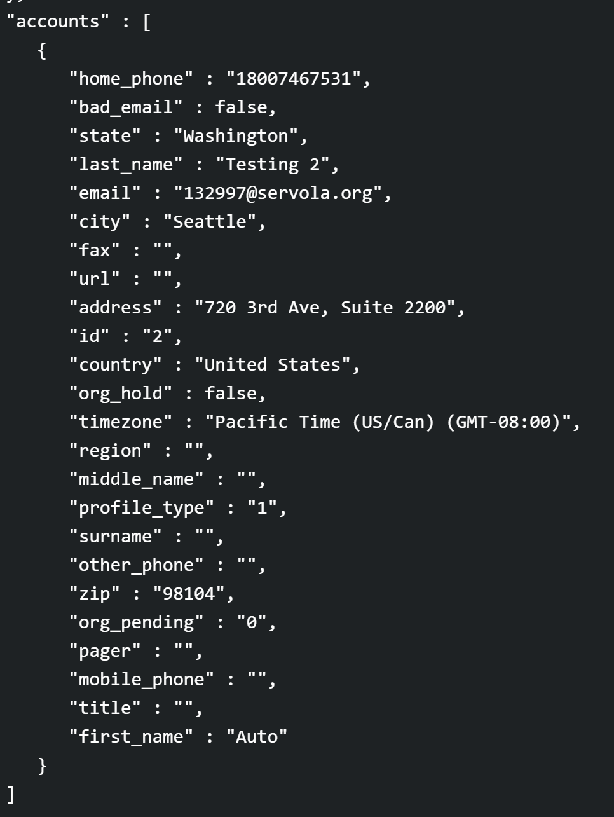
Account Object fields used
Shiftboard API | Shiftboard UI
External_ID | PO
Name | Name
Address | Address
City | City
State | State
Email | Email
Mobile_phone | Mobile Phone

Slide 11
Editing the Config File
The config file contains all the required data for the emails to be sent out and for the data to be grabbed
The config files gets re-read each time the program runs so any edits will be applied every run

